Slide 1
Briefing to the Executive Secretary Walkthrough Presentation for UNCC-AA Renovation Project - Phase 2 + Phase 3
16 November 2020
Addis Ababa, Ethiopia

Slide 2
Accomplishments of UNCC-AA Phase 1 project
Successful procurement and installation of;
2 large LED screens and their 2 UPS systems for CR1 and CR2
HD Wifi equipment for the whole UNECA compound
80 Yoga laptops
21 water dispensers for the Conference area
20 totems for Conference of Ministers 2020
Video distribution infrastructure for LBR, CR4-CR5
Accomplishments of 2 TEMPORARY Davos style stages for CR1 and CR2 and structural mounting of new Video Screens (1 permanent in CR2 and 1 temporary in CR1).
Completion of Video feed telecommunications fibre cabling for CR1, CR2 and Niger building
Successful enhancement of audio-visual projection in other smaller conference rooms for CR3 to CR6 and LBR
Delivery of an e-Conference platform - CoM2020 Conference Website and Paper smart portal, procurement and installation of 1 digital printer

Slide 3
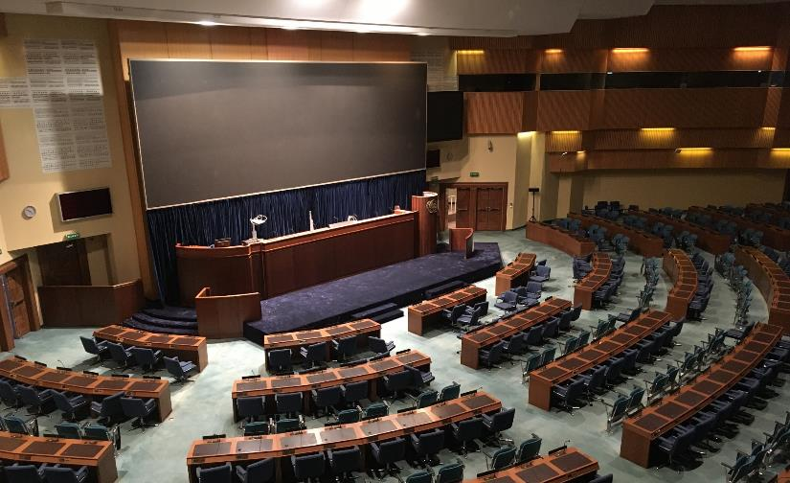
PHASE 1 - CR1
Installation of 12x4m LED wall
(temporary installation due to time constraints - standing steel frame fixed to existing structure)
Retain Upper Podium for Conference Services during interim
Davos Style accessible stage
modification of a single delegate desk for accessible access

Slide 4
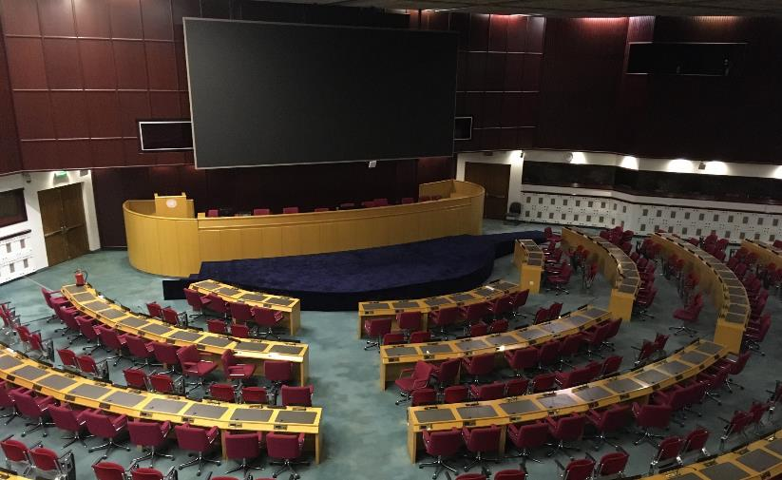
PHASE 1 – CR2
9x4m LED wall suspended from ceiling on rigid metal frame, speakers relocated to sides in existing cut-outs
(permanent installation)
Retain Upper Podium for Conference Services during interim
Davos Style accessible stage
Proposal is for modification of a single delegate desk for accessible access

Slide 5
UNCC-AA PHASE 1 Project Costs

Slide 6
Planned work for UNCC-AA Phase 2 Project – 2021 onwards
Architectural improvements for CR1 and CR2 for permanent stages, accessibility and carpeting/permanent power and accessible rostrums/speakers lecterns
Conference Management Simultaneous Interpretation, Voting system and Digital Displays for CR1-6, SBR and LBR
Audio-visual Improvements for CR1-6, SBR and LBR
IT-related enhancements for conference rooms on;
Audio-visual improvements
Sound system improvements
Procurement and installation of robotic cameras
Podium, design and furniture/equipment enhancements at UNCC-AA
Design and re-furbishing of the VIP lounge.
Design and re-furbishing of the lobbies in front of the Conference Rooms
Design and re-furbishing of Press Bar

Slide 7
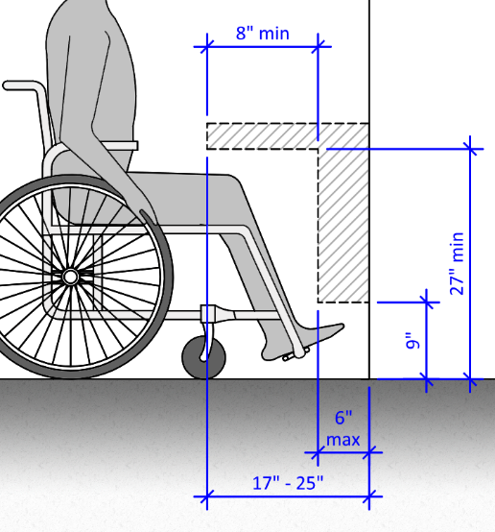
PHASE 2 - CR1 and CR2 Upgrades
Documentation completed for CR1 and CR2 accessibility upgrades to the podium – ready to Tender
Includes new power to delegate desks
Other projects to be implemented in parallel (delegate audio and signage upgrades)

Slide 8
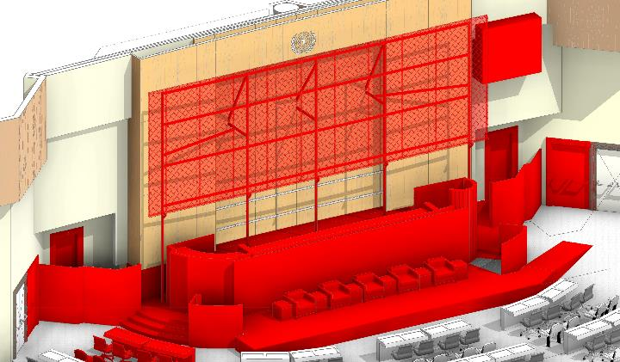
PHASE 2 CR1 - Demolition and removal
Removal of all frames and redundant screens and modification of rear wall in preparation for permanent works
Changes to side access doors
Permanent removal of existing podiums
Permanent removal of selected delegate
desks for accessibility requirements

Slide 9
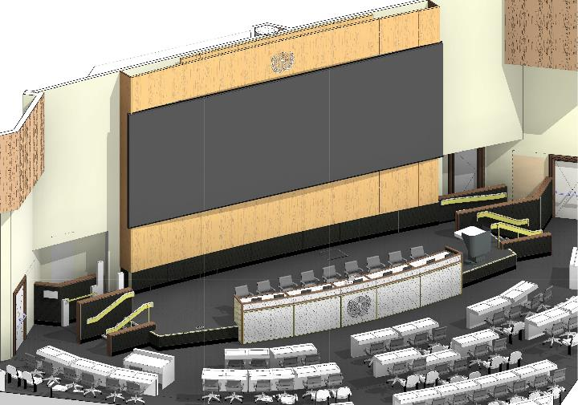
PHASE 2 CR1 – speakers podium arrangement
12x4m LED wall fully integrated within rear wall panel joinery
New access ramp to VIP lounge
New stair and ramp access to stage level with platform lift from delegate level required due to space constraints
Accessible speakers desks and podium refurbishment with modifications to allow for flexible stage arrangements.
Replacement carpet, power to delegate desks and a selected desk made to accessible height.

Slide 10
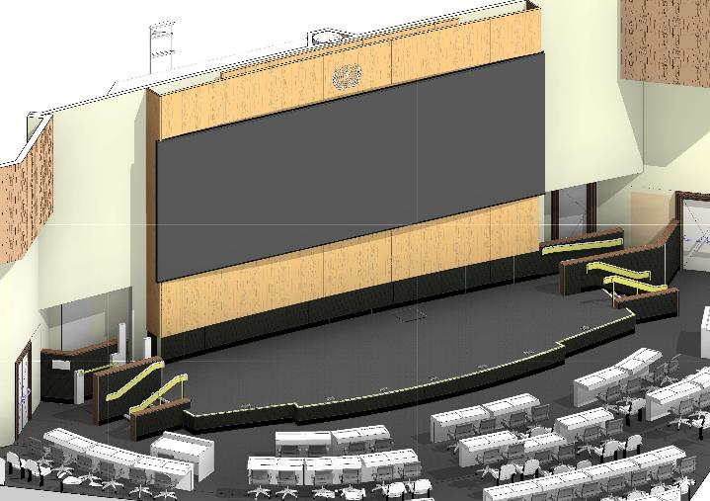
PHASE 2 CR1 – open stage arrangement
Open plan stage arrangement - made possible with easily removable furniture for flexible use (custom design)

Slide 11
Accessible Rostrum / speakers lectern
Clear Acrylic Appearance
(availability of accessible /
adjustable units to be explored)
Accessible furniture
adjustable height speakers lectern
(suggested concept design)

Slide 12
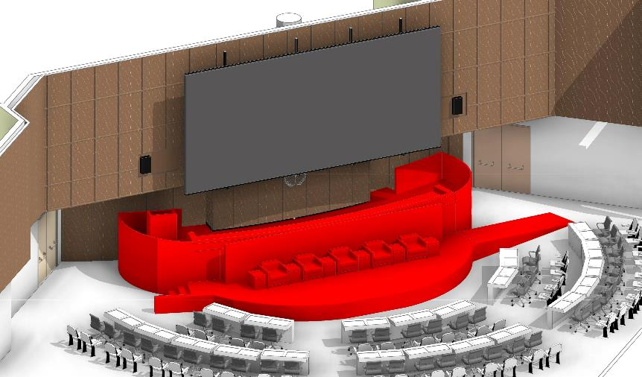
PHASE 2 CR2 - Demolition and removal
Screen permanent fixed for COM2020
Final Position of UN logo to be confirmed
Permanent removal of existing podiums

Slide 13
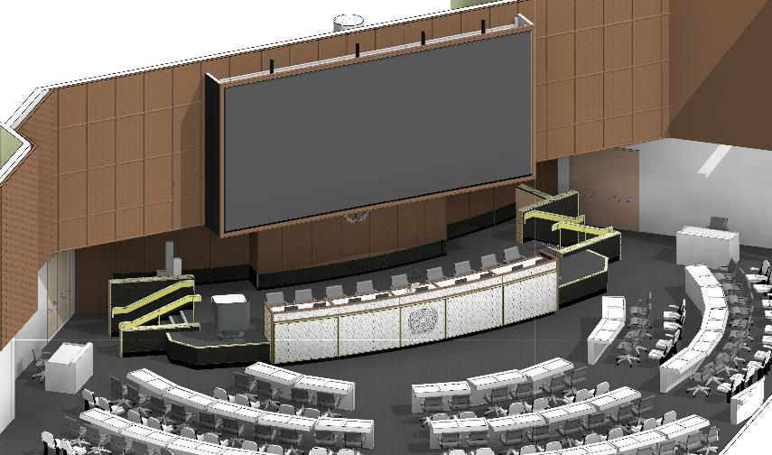
PHASE 2 CR2 – speakers podium arrangement
9x4m LED wall suspended from ceiling on rigid metal frame, speakers relocated to sides in existing cut-outs
UN logo to be positioned for best line of sight from delegates desks
New stair and platform elevator access to stage level. No accessible ramps possible in CR2 due to space constraints
Accessible speakers desks and podium refurbishment with modifications to allow for flexible stage arrangements.
Replacement carpet, power to delegate desks and a selected desk made to accessible height.

Slide 14
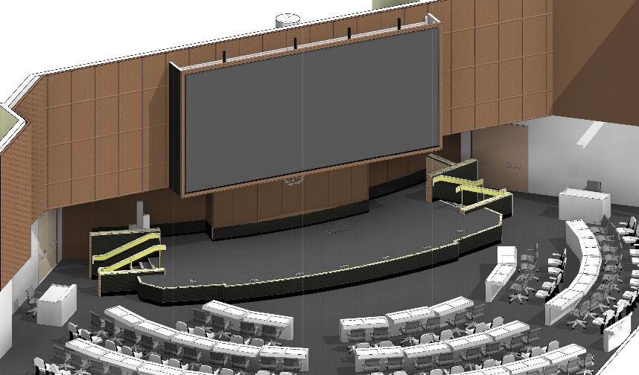
PHASE 2 CR2 – open stage arrangement
Open plan stage arrangement - made possible with easily removable furniture for flexible use (custom design)

Slide 15
PHASE 2 - Design and Documentation for Tender
Revised Tender Package completed for issue to bidders
CONSTRUCTION
Implementation is to be staged between conference halls - to keep one main room available at all times
Construction estimated to begin in CR1 in Q2 2021 (9 months)
Construction estimated to begin in CR2 in Q1 2022 (7 months)
Note: Major conference to be held in October 2022 requiring all upgrades to be complete, with facilities operational and ready to use
PHASE 2 - Construction Milestones

Slide 16
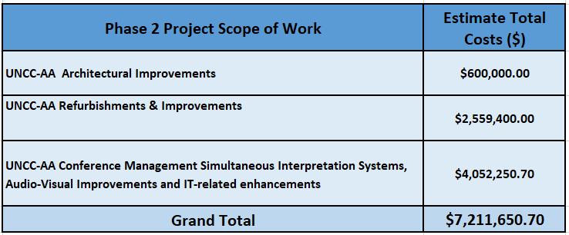
UNCC-AA PHASE 2 Project Cost Estimates

Slide 17
UNCC-AA PHASE 2 Project Risks and Constraints

Slide 18
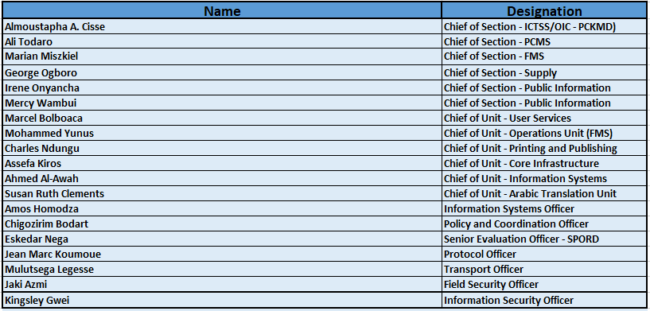
UNCC-AA PHASE 1 – Recognition of the Project team

Slide 19
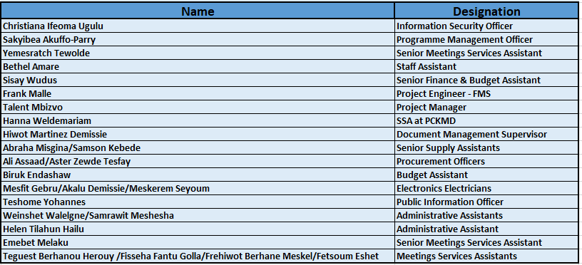
UNCC-AA PHASE 1 – Recognition of the Project team (Continued)

Slide 20
Thank you for your attention.

