Slide 1
VNRs and the HLPF in 2020
Tonya Vaturi
Office of Intergovernmental Support and Coordination for Sustainable Development
UN DESA
VNR Workshop
24 February 2020
Africa Regional Forum for Sustainable Development
Victoria Falls, Zimbabwe
Notes:
Preparation of the VNR report and national priorities of the voluntary national review: Review of VNR principles, guidelines, lessons learned and best practices from four years of VNRs. Stakeholder engagement, setting national priorities, tips for drafting
Format and organization of reviews at the high-level political forum: Timeline and checklist for preparing VNRs this year, and what to expect when presenting the VNR report at the HLPF in 2020

Slide 2
Support to the VNR process
UN DESA in cooperation with UN country teams, regional commissions and regional and subregional organizations as appropriate conducts a preparatory process for VNR countries through:
3 global workshops
Regional and subregional workshops in UN regions
Individual assistance upon request from countries
Preparation of synthesis report of VNR reports each year
SG voluntary common reporting guidelines
Synthesis of main messages from VNR reports
Handbook on preparation for VNRs updated each year
Webinars as needed

Slide 3
How can the VNR process support national implementation of the 2030 Agenda?
Strengthens political will, national ownership, institutions and coordination
Identifies areas where support is needed
Provides an important communication tool
Changes mindsets
Draws lessons and provides critical reflections on the process
Provides impetus to continue national implementation after the VNR has been presented at the HLPF

Slide 4
Principles of Voluntary National Reviews
Voluntary
State-led
Platform for partnerships
encourage reporting and include developed and developing countries
country driven reviews of progress at national and sub-national levels
including through the participation of major groups and other relevant stakeholders
Learning experience
facilitate the sharing of experiences, including successes, challenges and lessons learned, part of a process
National circumstances
reviews in accordance with national circumstances, policies and priorities, together with relevant partners
Open, Inclusive, Transparent
Facilitates communication with all stakeholders
Notes:
The 2030 Agenda defines a set of Principles to guide the follow-up and review process through the VNRs.
They should be Voluntary and State-led, to encourage both developed and developing countries to track their own national and sub-national progress in implementing the SDGs, including the means of implementation. This often requires enhanced capacity-building support for developing countries, including strengthening of national data systems and evaluation mechanisms
They should provide a Platform for Partnerships, fostering the inclusion of major groups and other stakeholders, building on existing platforms and processes, avoiding duplication, and minimizing the reporting burden. They can benefit from the active support of the UN system and other multilateral institutions
The VNR process provides a national Learning Experience– sharing success and challenges based on evidence, informed by country-led evaluations and disaggregated data
VNRs should take into account different national circumstances, policies and priorities, as well as sub-national realities and capacities
The process of developing and undertaking a review must be open, inclusive, participatory and transparent. This means people-centered, gender-sensitive, with respect for human rights, a focus on the poorest most vulnerable, leaving no one behind
[Full text: paragraph 74 of the 2030 Agenda for Sustainable Development]

Slide 5
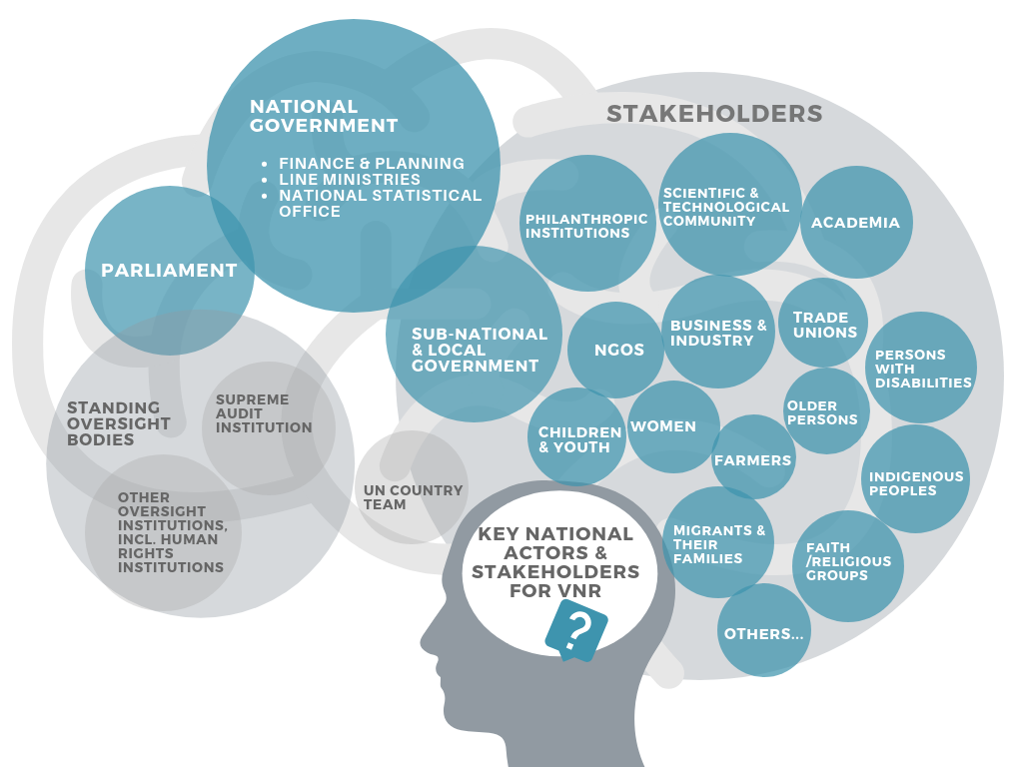
Stakeholder consultation and outreach
Notes:
Although a VNR must be initiated by the national Government, The VNR process involves many different types of actors, as this image illustrates.
Consideration should be given throughout the process as to how to support reporting by relevant stakeholders, how those contributions will be reflected in the final report, and how ongoing stakeholder involvement will be reflected in the implementation of the 2030 Agenda
Contact relevant government departments (line ministries) and agencies, setting out basic details, e.g. about the VNR, the information/data requested, and establishment of a focal point.
Develop stakeholder engagement plan which identifies key stakeholders, and method of engagement (consider offline and online options).
Establish awareness-raising and public outreach component to disseminate avenues for stakeholder engagement in the VNR process, making use of government communication services, social media, etc.
Make sure targeted efforts are made to reach groups that are marginalised and at risk of being left behind.

Slide 6
Prioritization and National Priorities
Assign responsibility for coordinating and preparing the VNR.
Estimate and identify resources required.
Consider scope of review.
Develop work plan/road map with deliverables aligned to HLPF deadlines (e.g. submission of Main Messages and VNR Report).
Map key national actors (e.g. Parliament, line ministries, national statistical office, local government officials, stakeholders).
Prepare draft outline of VNR and develop key messages.
Assign information- and data-gathering tasks, including drawing on existing national documents and previous VNR reports.

Slide 7
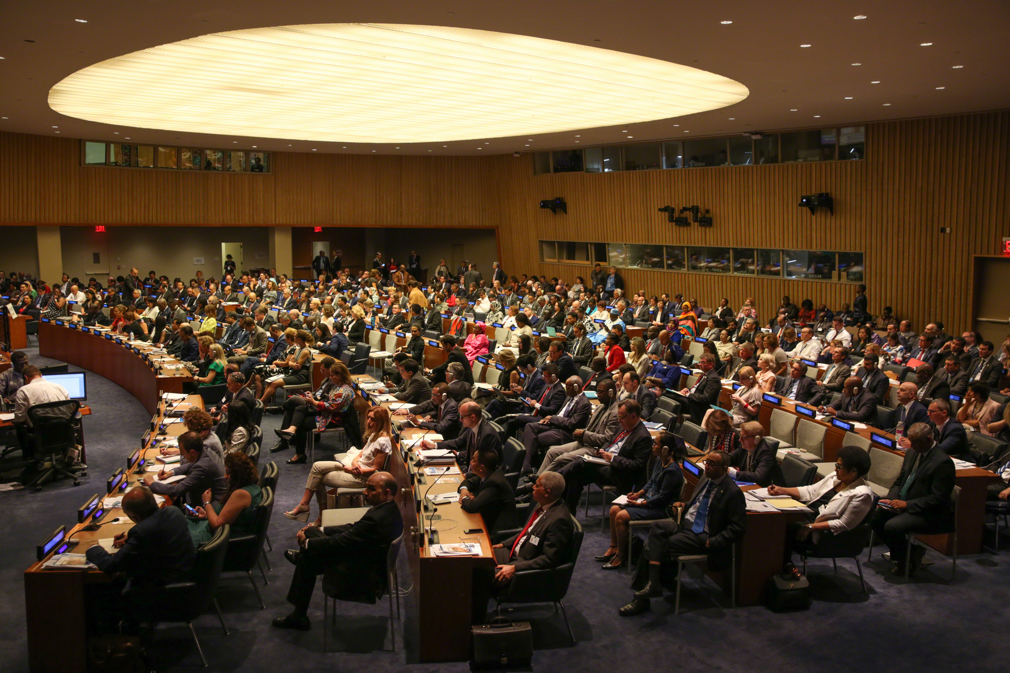
Best Practices in VNR Development
Focus on quality, not quantity
Include a statistical annex, if suitable
Address implementation of all 17 SDGs
Include analysis, lessons learned and detailed examples
Avoid listings of strategies and programmes
Showcase both strengths and weaknesses
Identify areas where additional support is needed
Spell out the next steps in implementation

Slide 8
Lessons learned from 2019 VNR countries
Decide the means and methods for including stakeholders
Include your UN mission at every stage
Include policy guidance and technical advisory tiers
Include all administrative regions
Determine drafting arrangements early
Select presenting team early
Make the VNR presentation for the HLPF unique
Notes:
Make a work plan that includes consultations with stakeholders early on, and arrange the means for their inclusion. Decide wither the NGO sector will be encouraged to include a “shadow” report.
Include your country’s mission to the UN at every stage, using Skype, WhatsApp, and Facetime, where possible
Make institutional arrangements that include a policy guidance tier AND a technical advisory tier
If there are many administrative regions, or if many islands make up your country, ensure that institutional arrangements include the regional governments
Determine drafting arrangements early—who will draft what, and by when?
Know your presenting team well ahead of the HLPF, if possible
Make your HLPF presentation interesting and unique. Tell your story.

Slide 9
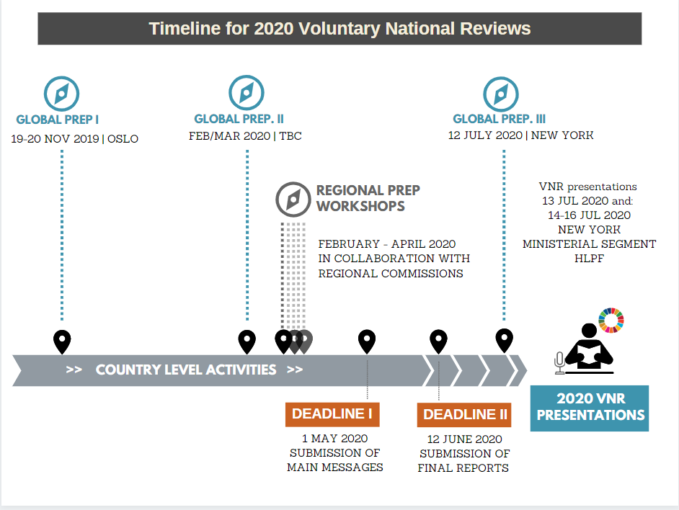
Timeline for 2020 VNRs
Submission of Main Messages
TBD
Notes:
Second Global workshop

Slide 10
VNR preparation checklist
Review and incorporate material received, including data, other reports and previous VNRs.
Follow-up with government colleagues/information providers to secure missing material or provide additional analysis.
Decide on participants for the preparatory global and regional workshops.
Prepare zero draft, including identifying remaining gaps, together with stakeholders.
Prepare draft of Main Messages (not more than 700 words) for approval and submission to DESA by 1 May 2020.
Carry out internal review of VNR, including quality control, allowing time for resolution of possibly contentious issues.
Establish comment period and circulate draft to relevant government officials.
Provide opportunity for stakeholders to comment and integrate comments from all national actors and stakeholders to the greatest extent possible.
Edit the VNR and arrange for translation into English, if needed/desirable, and design and layout.
Submit for endorsement and approval if required (for example to the Minister, Prime Minister, Cabinet).
Transmit electronic copy of the VNR to DESA by 12 June 2020.

Slide 11
Tips for the drafting process
Use the SG’s updated guidelines for comparability reasons
Have a solid drafting team in place, focusing on main messages
Prepare a national roadmap taking into account time for consultations within and outside the government,
Identify a clear approval process and budgeting time for it
Use extra time if translation into one of the six official UN languages is needed
Remember the two deadlines of 1 May and 12 June 2020

Slide 12
Other opportunities at the HLPF
General Debate
VNR Labs
Exhibitions
Special Events
Bilateral meetings
Side Events

Slide 13
Format and Organization of VNR presentations at the HLPF
First time presenters: individual or panel format, 15 min presentation, 15 min discussion
Second and third time presenters: panel format only, 10 min presentation, 10 min discussion
3-5 countries present consecutively with Q&A after all countries have finished presenting
Single country presentation followed by Q&A
Individual Format
Panel Format
Notes:
As was the case for the VNRs presented in previous years (2016-2019), it is expected that countries will utilize either a panel or individual format. In the panel format, the countries in a VNR session (between two and four) each make their presentation. Once all countries in the session have presented, questions are posed to the presenting countries.
In the individual format, a single country presents, followed by questions from countries in the audience, as well as from Major groups and other stakeholders.
Regardless of the format, countries presenting for the first time have fifteen minutes to present and fifteen minutes to interact with participants. This is then followed by the next VNR country in that VNR session.
Countries presenting a VNR for the second time or third time will present in a panel format, with ten minutes to present and ten minutes for Q&A.
In 2019, presentations were made mostly by government representatives, but in some cases also by members of civil society, youth representatives and the private sector as part of the official delegation. Use can be made of slide presentations (PowerPoint) and short films. However, it is up to the countries to decide on their format of presentation.
Countries presenting a VNR for the first time will have 15 minutes for their presentation, followed by a similar amount of time for questions from other countries and stakeholders and factoring in time for podium changes.
The 15-minute time allocation includes the use of audio-visual material, including videos.
Countries presenting a VNR for the second time will be allocated a total of 20 minutes each in a panel format: 10 minutes will be allocated for the VNR presentation and 10 min for Q&A.
The presentations at the HLPF are intended to focus on the key messages emanating from the review process.

Slide 14
Resources
VNR Handbook – 2020 edition
Voluntary Reporting Guidelines- 2020 edition
Knowledge Exchange Booklet- approaches and tools for VNRs
VNR Synthesis Reports
All available at:
https://sustainabledevelopment.un.org/vnrs/

Slide 15
What can be done to maximize benefits from the VNRs?
Embed VNRs into institutions and link the VNRs to report to other mechanisms and conventions
Undertake costing analysis for SDGs and align with national budgets
Strengthen policy coherence, interlinkages among SDGs and assess trade-offs
Monitor SDG implementation including through parliaments and supreme audit institutions
Measure impacts of strategies and polices put in place
Report at the national level before and after a VNR has been presented at the HLPF
Strengthen VNR follow-up by implementing lessons learned from other countries at HLPF
Take actions in the executive and legislative branches of government

Slide 16
Thank you!

